Slide 1
Dynamic Programming
Longest Common Subsequence

Slide 2
Introduction
Biological applications often need to compare the DNA of two (or more) different organisms.
A strand of DNA consists of a string of molecules called bases
Where the possible bases are adenine, guanine, cytosine, and thymine.
Representing each of these bases by its initial letter, we can express a strand of DNA as a string over the finite set {A; C; G; T}.
For example, the DNA of one organism may be S1=ACCGGTCGAGTGCGCGGAAGCCGGCCGAA, and the DNA of another organism may be S2= GTCGTTCGGAATGCCGTTGCTCTGTAAA.

Slide 3
Introduction
One reason to compare two strands of DNA is to determine how “similar” the two strands are, as some measure of how closely related the two organisms are.
We can, and do, define similarity in many different ways.
For example, we can say that two DNA strands are
similar if one is a substring of the other.

Slide 4
Longest-Common-Subsequence Problem
Another way to measure the similarity of strands S1 and S2 is by finding a third strand S3 in which the bases in S3 appear in each of S1 and S2;
These bases must appear in the same order, but not necessarily consecutively.
The longer the strand S3 we can find, the more similar S1 and S2 are.
In our example, the longest strand S3 is GTCGTCGGAAGCCGGCCGAA.
Longest-Common-Subsequence Problem

Slide 5
Dynamic programming
Design technique, like divide-and-conquer.
Example: Longest Common Subsequence (LCS)
Given two sequences x[1 . . m] and y[1 . . n], find a longest subsequence common to them both.
November 7, 2005
L15.2

Slide 6
Dynamic programming
Design technique, like divide-and-conquer.
Example: Longest Common Subsequence (LCS)
Given two sequences x[1 . . m] and y[1 . . n], find a longest subsequence common to them both.
“a” not “the”
November 7, 2005
L15.3

Slide 7
Dynamic programming
Dynamic programming
Design technique, like divide-and-conquer.
Example: Longest Common Subsequence (LCS)
Given two sequences x[1 . . m] and y[1 . . n], find a longest subsequence common to them both.
“a” not “the”
x: | A | B | C | B | D | A | B
y: | B | D | C | A | B | A
November 7, 2005
L15.4

Slide 8
Dynamic programming
Dynamic programming
Design technique, like divide-and-conquer.
Example: Longest Common Subsequence (LCS)
Given two sequences x[1 . . m] and y[1 . . n], find a longest subsequence common to them both.
“a” not “the”
x: A B C B D A B
y: B D C A B A
BCBA = LCS(x, y)
functional notation, but not a function
November 7, 2005
L15.5

Slide 9
Example
X : ABCDEFGHIJ
Y : CDGI
Z :CDGI

Slide 10
Example
X : ABCDEFGHIJ
Y : FCDHJ
Z :FHJ
X : ABCDEFGHIJ
Y : FCDHJ
Z :CDHJ
LCS

Slide 11
Example
X : ABDACE
Y : BABCE
Z :BACE
X : ABDACE
Y : BABCE
Z :ABCE
LCS

Slide 12
Brute-force LCS algorithm
In a brute-force approach to solving the LCS problem, we would enumerate all subsequences of X and check each subsequence to see whether it is also a subsequence of Y ,
Keeping track of the longest subsequence we find. Each subsequence of X corresponds to a subset of the indices {1, 2 , . . ., m} of X.
Because X has 2^{m} subsequences,
This approach requires exponential time, making it impractical for long sequences.

Slide 13
Brute-force LCS algorithm
Check every subsequence of x[1 . . m] to see if it is also a subsequence of y[1 . . n].
November 7, 2005
L15.6

Slide 14
Brute-force LCS algorithm
Check every subsequence of x[1 . . m] to see if it is also a subsequence of y[1 . . n].
Analysis
Checking = O(n) time per subsequence.
2^{m} subsequences of x (each bit-vector of length m determines a distinct subsequence of x).
Worst-case running time = O(n2^{m})
= exponential time.
November 7, 2005
L15.7

Slide 15
Towards a better algorithm
Simplification:
Look at the length of a longest-common subsequence.
Extend the algorithm to find the LCS itself.
November 7, 2005
L15.8

Slide 16
Towards a better algorithm
Simplification:
The LCS problem has an optimal-substructure property.
The natural classes of subproblems correspond to pairs of “prefixes” of the two input sequences
Given a sequence X =<x₁, x₂, . . . , x_{m}>, we define the i^{th} prefix of X,
for i = 0, 1, . .., m as X_{i} =<x₁, x₂, . . . , x_{m}>
For example, if X = <A, B, C, B, D, A, B>, then X₄ = <A,B,C,B> and X₀ is the empty sequence.
November 7, 2005
L15.9

Slide 17
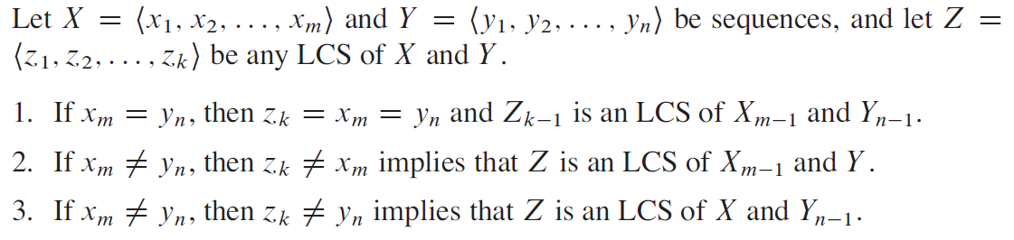
Optimal substructure -LCS

Slide 18
Recursive Solution
We should examine either one or two subproblems when finding an LCS of X =<x₁, x₂, . . . , x_{m}>, and Y =<y₁, y₂, . . . , y_{n}>, .
If x_{m} = y_{n}, we must find an LCS of X_{m-1} and Y_{n-1}
If x_{m} ≠ y_{n}, then we must solve two subproblems:
Finding an LCS of X_{m-1} and Y
and finding an LCS of X and Y_{n-1}
Whichever of these two LCSs is longer is an LCS of X and Y .
these cases exhaust all possibilities,
we know that one of the optimal subproblem solutions must appear within an LCS of X and Y .

Slide 19
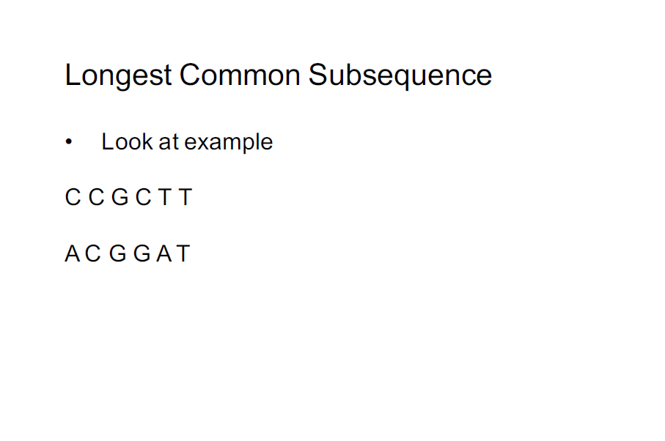

Slide 20
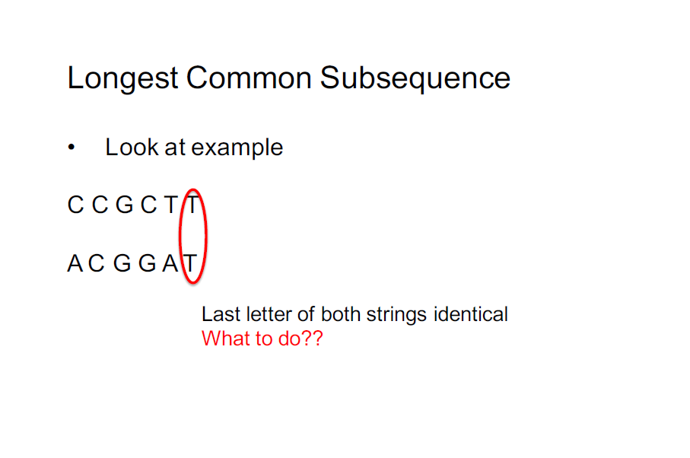

Slide 21
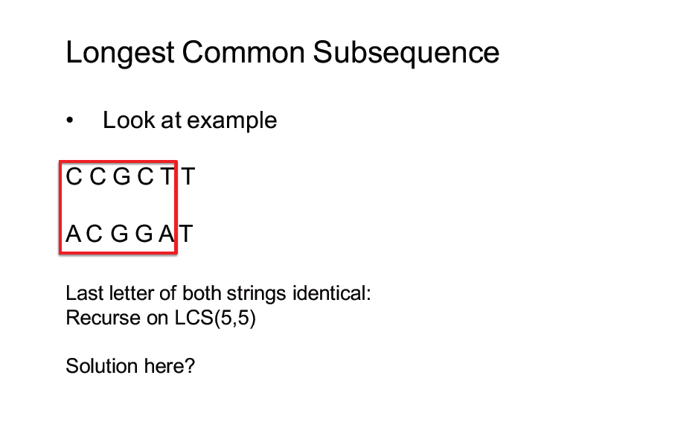

Slide 22
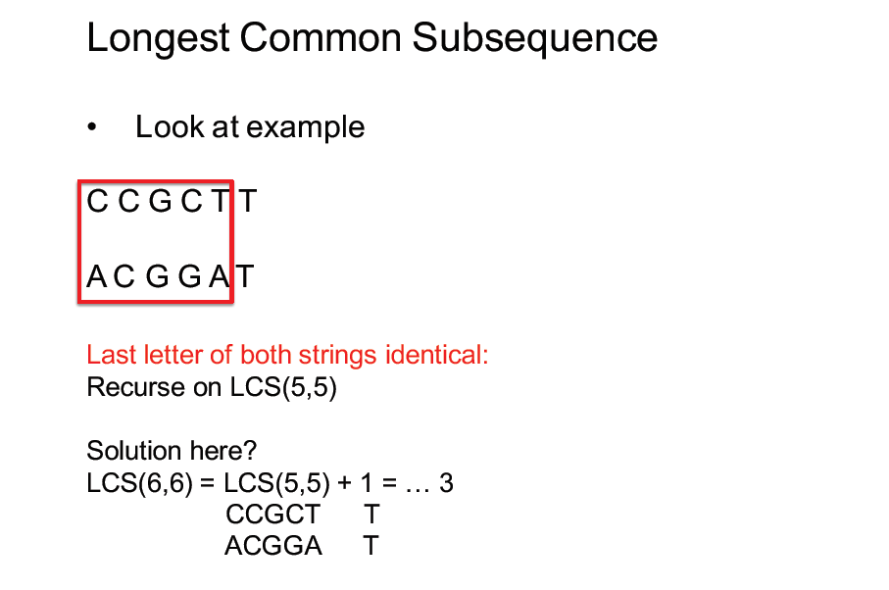

Slide 23
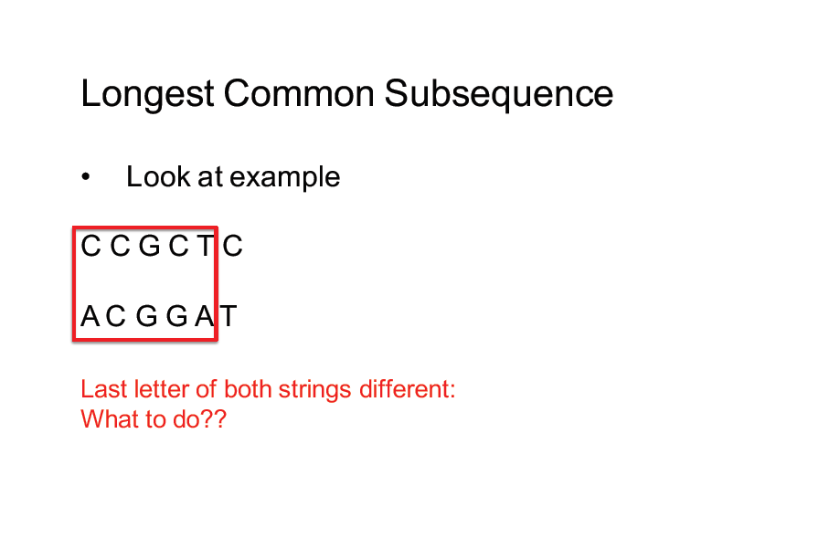

Slide 24
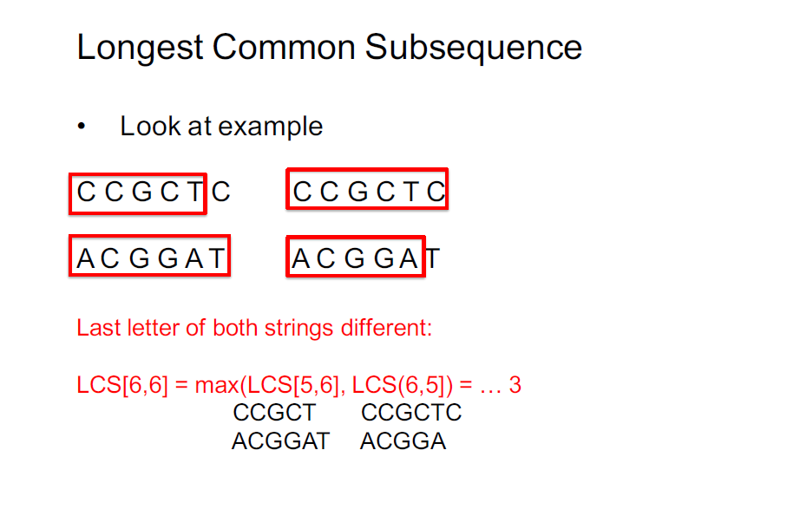

Slide 25
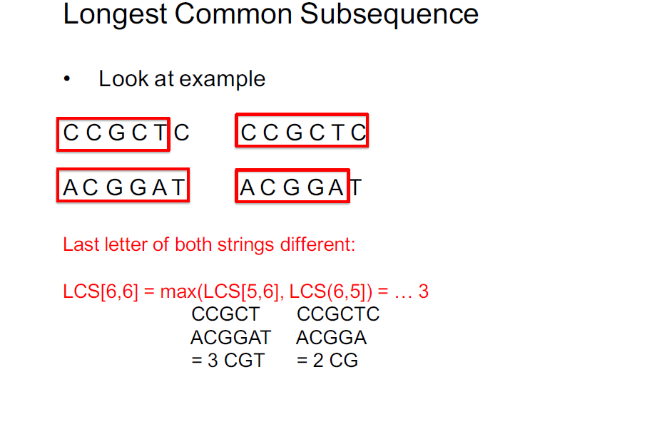

Slide 26
Overlapping-Subproblem - LCS
We can readily see the overlapping-subproblems property in the LCS problem.
To find an LCS of X and Y , we may need to find the LCSs of X and Y_{n-1} and of X_{m-1} and Y .
But each of these subproblems has the subsubproblem of finding an LCS of X_{m-1} and Y_{n-1}
Many other subproblems share subsubproblems.

Slide 27
Towards a better algorithm
Simplification:
Look at the length of a longest-common subsequence.
Extend the algorithm to find the LCS itself.
Notation: Denote the length of a sequence s
by | s |.
November 7, 2005
L15.9

Slide 28
Towards a better algorithm
Simplification:
Look at the length of a longest-common subsequence.
Extend the algorithm to find the LCS itself.
Notation: Denote the length of a sequence s
by | s |.
Strategy: Consider prefixes of x and y.
Define c[i, j] = | LCS(x[1 . . i], y[1 . . j]) |.
Then, c[m, n] = | LCS(x, y) |.
the length of an LCS of the sequences X_{i} and Y_{j}.
November 7, 2005
L15.10

Slide 29
Recursive formulation
Theorem.
0 if i=0 or j=0
c[i, j] =
c[i–1, j–1] + 1 if x[i] = y[j],
max{c[i–1, j], c[i, j–1]} otherwise.
The optimal substructure of the LCS problem gives the recursive formula
November 7, 2005
L15.11

Slide 30
Recursive formulation
Theorem.
0 if i=0 or j=0
c[i, j] =
c[i–1, j–1] + 1 if x[i] = y[j],
max{c[i–1, j], c[i, j–1]} otherwise.
When x_{i} =y_{j} , we can and should consider
the subproblem of finding an LCS of X_{i-1} and Y_{j-1}.
Otherwise, we instead consider the two subproblems of finding an LCS of X_{i} and Y_{j-1} and of X_{i-1} and Y_{j}.
November 7, 2005
L15.11
Notes:
In the previous dynamic-programming algorithms we have examined—for rod cutting and matrix-chain multiplication—we ruled out no subproblems due to conditions in the problem. Finding an LCS is not the only dynamic-programming algorithm that rules out subproblems based on conditions in the problem.

Slide 31

Dynamic-programming hallmark #1
Optimal substructure
An optimal solution to a problem (instance) contains optimal solutions to subproblems.
November 7, 2005
L15.16

Slide 32
Dynamic-programming hallmark #1
Optimal substructure
An optimal solution to a problem (instance) contains optimal solutions to subproblems.
If z = LCS(x, y), then any prefix of z is an LCS of a prefix of x and a prefix of y.
November 7, 2005
L15.17

Slide 33
Recursive algorithm for LCS
LCS(x, y, i, j) // ignoring base cases
if x[i] = y[ j]
then c[i, j] ← LCS(x, y, i–1, j–1) + 1
else c[i, j] ← max{ LCS(x, y, i–1, j),
LCS(x, y, i, j–1)}
return c[i, j]
November 7, 2005
L15.18

Slide 34
Recursive algorithm for LCS
LCS(x, y, i, j) // ignoring base cases
if x[i] = y[ j]
then c[i, j] ← LCS(x, y, i–1, j–1) + 1
else c[i, j] ← max{ LCS(x, y, i–1, j),
LCS(x, y, i, j–1)}
return c[i, j]
Worse case: x[i] ≠ y[ j], in which case the algorithm evaluates two subproblems, each with only one parameter decremented.
November 7, 2005
L15.19

Slide 35






























Recursion tree
m = 7, n = 6:
7,6
6,6
7,5
5,6
6,5
6,5
7,4
4,6
5,5
5,5
6,4
5,5
6,4
6,4
7,3
November 7, 2005
L15.20

Slide 36
Recursion tree
m = 7, n = 6:
7,6
6,6
7,5
m+n
5,6
6,5
6,5
7,4
4,6
5,5
5,5
6,4
5,5
6,4
6,4
7,3
Height = m + n ⇒ work potentially exponential.
November 7, 2005
L15.21

Slide 37
Recursion tree
m = 7, n = 6:
7,6
6,6
same subproblem
6,5
6,4 5,5
7,5
m+n
5,6
6,5
7,4
4,6
5,5
5,5
6,4
6,4
7,3
Height = m + n ⇒ work potentially exponential., but we’re solving subproblems already solved!
November 7, 2005
L15.22

Slide 38
Dynamic-programming hallmark #2
Overlapping subproblems
A recursive solution contains a “small” number of distinct subproblems repeated many times.
November 7, 2005
L15.23

Slide 39
Dynamic-programming hallmark #2
Overlapping subproblems
A recursive solution contains a “small” number of distinct subproblems repeated many times.
The number of distinct LCS subproblems for two strings of lengths m and n is only mn.
November 7, 2005
L15.24

Slide 40
Memoization algorithm
Memoization: After computing a solution to a subproblem, store it in a table. Subsequent calls check the table to avoid redoing work.
November 7, 2005
L15.25

Slide 41
Memoization algorithm
Memoization: After computing a solution to a subproblem, store it in a table. Subsequent calls check the table to avoid redoing work.
LCS(x, y, i, j)
if c[i, j] = NIL
then if x[i] = y[j]
same
then c[i, j] ← LCS(x, y, i–1, j–1) + 1
else c[i, j] ← max{LCS(x, y, i–1, j),
LCS(x, y, i, j–1)}
as before
November 7, 2005
L15.26

Slide 42
Memoization algorithm
Memoization: After computing a solution to a subproblem, store it in a table. Subsequent calls check the table to avoid redoing work.
LCS(x, y, i, j)
if c[i, j] = NIL
then if x[i] = y[j]
same
then c[i, j] ← LCS(x, y, i–1, j–1) + 1
else c[i, j] ← max{LCS(x, y, i–1, j),
LCS(x, y, i, j–1)}
as before
Time = Θ(mn) = constant work per table entry. Space = Θ(mn).
November 7, 2005
L15.27

Slide 43
Recursive formulation
Theorem.
0 if i=0 or j=0
c[i, j] =
c[i–1, j–1] + 1 if x[i] = y[j],
max{c[i–1, j], c[i, j–1]} otherwise.
When x_{i} =y_{j} , we can and should consider
the subproblem of finding an LCS of X_{i-1} and Y_{j-1}.
Otherwise, we instead consider the two subproblems of finding an LCS of X_{i} and Y_{j-1} and of X_{i-1} and Y_{j}.
November 7, 2005
L15.11
Notes:
In the previous dynamic-programming algorithms we have examined—for rod cutting and matrix-chain multiplication—we ruled out no subproblems due to conditions in the problem. Finding an LCS is not the only dynamic-programming algorithm that rules out subproblems based on conditions in the problem.

Slide 44


Dynamic-programming algorithm
IDEA:
Compute the table bottom-up.
 |  | A | B | C | B | D | A | B
 | 0 | 0 | 0 | 0 | 0 | 0 | 0 | 0
B | 0 | 0
D | 0
C | 0
A | 0
B | 0
A | 0
max
max{c[i–1, j], c[i, j–1]}
November 7, 2005
L15.28

Slide 45
Dynamic-programming algorithm
c[i, j] ← LCS(x, y, i–1, j–1) + 1
IDEA:
Compute the table bottom-up.
 |  | A | B | C | B | D | A | B
 | 0 | 0 | 0 | 0 | 0 | 0 | 0 | 0
B | 0 | 0 | 1
D | 0
C | 0
A | 0
B | 0
A | 0
November 7, 2005
L15.28

Slide 46
Dynamic-programming algorithm
IDEA:
Compute the table bottom-up.
 |  | A | B | C | B | D | A | B
 | 0 | 0 | 0 | 0 | 0 | 0 | 0 | 0
B | 0 | 0 | 1 | 1
D | 0
C | 0
A | 0
B | 0
A | 0
max
November 7, 2005
L15.28

Slide 47
Dynamic-programming algorithm
IDEA:
Compute the table bottom-up.
 |  | A | B | C | B | D | A | B
 | 0 | 0 | 0 | 0 | 0 | 0 | 0 | 0
B | 0 | 0 | 1 | 1 | 1
D | 0
C | 0
A | 0
B | 0
A | 0
c[i, j] ← LCS(x, y, i–1, j–1) + 1
November 7, 2005
L15.28

Slide 48
Dynamic-programming algorithm
IDEA:
Compute the table bottom-up.
 |  | A | B | C | B | D | A | B
 | 0 | 0 | 0 | 0 | 0 | 0 | 0 | 0
B | 0 | 0 | 1 | 1 | 1 | 1
D | 0
C | 0
A | 0
B | 0
A | 0
max
November 7, 2005
L15.28

Slide 49
Dynamic-programming algorithm
IDEA:
Compute the table bottom-up.
 |  | A | B | C | B | D | A | B
 | 0 | 0 | 0 | 0 | 0 | 0 | 0 | 0
B | 0 | 0 | 1 | 1 | 1 | 1 | 1
D | 0
C | 0
A | 0
B | 0
A | 0
max
November 7, 2005
L15.28

Slide 50
Dynamic-programming algorithm
IDEA:
Compute the table bottom-up.
 |  | A | B | C | B | D | A | B
 | 0 | 0 | 0 | 0 | 0 | 0 | 0 | 0
B | 0 | 0 | 1 | 1 | 1 | 1 | 1 | 1
D | 0
C | 0
A | 0
B | 0
A | 0
c[i, j] ← LCS(x, y, i–1, j–1) + 1
November 7, 2005
L15.28

Slide 51
Dynamic-programming algorithm
IDEA:
Compute the table bottom-up.
 |  | A | B | C | B | D | A | B
 | 0 | 0 | 0 | 0 | 0 | 0 | 0 | 0
B | 0 | 0 | 1 | 1 | 1 | 1 | 1 | 1
D | 0
C | 0
A | 0
B | 0
A | 0
November 7, 2005
L15.28

Slide 52
Dynamic-programming algorithm
IDEA:
Compute the table bottom-up.
 |  | A | B | C | B | D | A | B
 | 0 | 0 | 0 | 0 | 0 | 0 | 0 | 0
B | 0 | 0 | 1 | 1 | 1 | 1 | 1 | 1
D | 0 | 0
C | 0
A | 0
B | 0
A | 0
November 7, 2005
L15.28

Slide 53
Dynamic-programming algorithm
IDEA:
Compute the table bottom-up.
 |  | A | B | C | B | D | A | B
 | 0 | 0 | 0 | 0 | 0 | 0 | 0 | 0
B | 0 | 0 | 1 | 1 | 1 | 1 | 1 | 1
D | 0 | 0 | 1
C | 0
A | 0
B | 0
A | 0
November 7, 2005
L15.28

Slide 54
Dynamic-programming algorithm
IDEA:
Compute the table bottom-up.
 |  | A | B | C | B | D | A | B
 | 0 | 0 | 0 | 0 | 0 | 0 | 0 | 0
B | 0 | 0 | 1 | 1 | 1 | 1 | 1 | 1
D | 0 | 0 | 1 | 1
C | 0
A | 0
B | 0
A | 0
November 7, 2005
L15.28

Slide 55
Dynamic-programming algorithm
IDEA:
Compute the table bottom-up.
 |  | A | B | C | B | D | A | B
 | 0 | 0 | 0 | 0 | 0 | 0 | 0 | 0
B | 0 | 0 | 1 | 1 | 1 | 1 | 1 | 1
D | 0 | 0 | 1 | 1 | 1
C | 0
A | 0
B | 0
A | 0
November 7, 2005
L15.28

Slide 56
Dynamic-programming algorithm
IDEA:
Compute the table bottom-up.
 |  | A | B | C | B | D | A | B
 | 0 | 0 | 0 | 0 | 0 | 0 | 0 | 0
B | 0 | 0 | 1 | 1 | 1 | 1 | 1 | 1
D | 0 | 0 | 1 | 1 | 1 | 2
C | 0
A | 0
B | 0
A | 0
November 7, 2005
L15.28

Slide 57
Dynamic-programming algorithm
IDEA:
Compute the table bottom-up.
 |  | A | B | C | B | D | A | B
 | 0 | 0 | 0 | 0 | 0 | 0 | 0 | 0
B | 0 | 0 | 1 | 1 | 1 | 1 | 1 | 1
D | 0 | 0 | 1 | 1 | 1 | 2 | 2
C | 0
A | 0
B | 0
A | 0
November 7, 2005
L15.28

Slide 58
Dynamic-programming algorithm
IDEA:
Compute the table bottom-up.
 |  | A | B | C | B | D | A | B
 | 0 | 0 | 0 | 0 | 0 | 0 | 0 | 0
B | 0 | 0 | 1 | 1 | 1 | 1 | 1 | 1
D | 0 | 0 | 1 | 1 | 1 | 2 | 2 | 2
C | 0
A | 0
B | 0
A | 0
November 7, 2005
L15.28

Slide 59
Dynamic-programming algorithm
IDEA:
Compute the table bottom-up.
 |  | A | B | C | B | D | A | B
 | 0 | 0 | 0 | 0 | 0 | 0 | 0 | 0
B | 0 | 0 | 1 | 1 | 1 | 1 | 1 | 1
D | 0 | 0 | 1 | 1 | 1 | 2 | 2 | 2
C | 0
A | 0
B | 0
A | 0
November 7, 2005
L15.28

Slide 60
Dynamic-programming algorithm
IDEA:
Compute the table bottom-up.
 |  | A | B | C | B | D | A | B
 | 0 | 0 | 0 | 0 | 0 | 0 | 0 | 0
B | 0 | 0 | 1 | 1 | 1 | 1 | 1 | 1
D | 0 | 0 | 1 | 1 | 1 | 2 | 2 | 2
C | 0 | 0
A | 0
B | 0
A | 0
November 7, 2005
L15.28

Slide 61
Dynamic-programming algorithm
IDEA:
Compute the table bottom-up.
 |  | A | B | C | B | D | A | B
 | 0 | 0 | 0 | 0 | 0 | 0 | 0 | 0
B | 0 | 0 | 1 | 1 | 1 | 1 | 1 | 1
D | 0 | 0 | 1 | 1 | 1 | 2 | 2 | 2
C | 0 | 0 | 1
A | 0
B | 0
A | 0
November 7, 2005
L15.28

Slide 62
Dynamic-programming algorithm
IDEA:
Compute the table bottom-up.
 |  | A | B | C | B | D | A | B
 | 0 | 0 | 0 | 0 | 0 | 0 | 0 | 0
B | 0 | 0 | 1 | 1 | 1 | 1 | 1 | 1
D | 0 | 0 | 1 | 1 | 1 | 2 | 2 | 2
C | 0 | 0 | 1 | 2
A | 0
B | 0
A | 0
November 7, 2005
L15.28

Slide 63
Dynamic-programming algorithm
IDEA:
Compute the table bottom-up.
 |  | A | B | C | B | D | A | B
 | 0 | 0 | 0 | 0 | 0 | 0 | 0 | 0
B | 0 | 0 | 1 | 1 | 1 | 1 | 1 | 1
D | 0 | 0 | 1 | 1 | 1 | 2 | 2 | 2
C | 0 | 0 | 1 | 2 | 2
A | 0
B | 0
A | 0
November 7, 2005
L15.28

Slide 64
Dynamic-programming algorithm
IDEA:
Compute the table bottom-up.
 |  | A | B | C | B | D | A | B
 | 0 | 0 | 0 | 0 | 0 | 0 | 0 | 0
B | 0 | 0 | 1 | 1 | 1 | 1 | 1 | 1
D | 0 | 0 | 1 | 1 | 1 | 2 | 2 | 2
C | 0 | 0 | 1 | 2 | 2 | 2
A | 0
B | 0
A | 0
November 7, 2005
L15.28

Slide 65
Dynamic-programming algorithm
IDEA:
Compute the table bottom-up.
 |  | A | B | C | B | D | A | B
 | 0 | 0 | 0 | 0 | 0 | 0 | 0 | 0
B | 0 | 0 | 1 | 1 | 1 | 1 | 1 | 1
D | 0 | 0 | 1 | 1 | 1 | 2 | 2 | 2
C | 0 | 0 | 1 | 2 | 2 | 2 | 2
A | 0
B | 0
A | 0
November 7, 2005
L15.28

Slide 66
Dynamic-programming algorithm
IDEA:
Compute the table bottom-up.
 |  | A | B | C | B | D | A | B
 | 0 | 0 | 0 | 0 | 0 | 0 | 0 | 0
B | 0 | 0 | 1 | 1 | 1 | 1 | 1 | 1
D | 0 | 0 | 1 | 1 | 1 | 2 | 2 | 2
C | 0 | 0 | 1 | 2 | 2 | 2 | 2 | 2
A | 0
B | 0
A | 0
November 7, 2005
L15.28

Slide 67
Dynamic-programming algorithm
IDEA:
Compute the table bottom-up.
 |  | A | B | C | B | D | A | B
 | 0 | 0 | 0 | 0 | 0 | 0 | 0 | 0
B | 0 | 0 | 1 | 1 | 1 | 1 | 1 | 1
D | 0 | 0 | 1 | 1 | 1 | 2 | 2 | 2
C | 0 | 0 | 1 | 2 | 2 | 2 | 2 | 2
A | 0
B | 0
A | 0
November 7, 2005
L15.28

Slide 68
Dynamic-programming algorithm
IDEA:
Compute the table bottom-up.
 |  | A | B | C | B | D | A | B
 | 0 | 0 | 0 | 0 | 0 | 0 | 0 | 0
B | 0 | 0 | 1 | 1 | 1 | 1 | 1 | 1
D | 0 | 0 | 1 | 1 | 1 | 2 | 2 | 2
C | 0 | 0 | 1 | 2 | 2 | 2 | 2 | 2
A | 0 | 1
B | 0
A | 0
November 7, 2005
L15.28

Slide 69
Dynamic-programming algorithm
IDEA:
Compute the table bottom-up.
 |  | A | B | C | B | D | A | B
 | 0 | 0 | 0 | 0 | 0 | 0 | 0 | 0
B | 0 | 0 | 1 | 1 | 1 | 1 | 1 | 1
D | 0 | 0 | 1 | 1 | 1 | 2 | 2 | 2
C | 0 | 0 | 1 | 2 | 2 | 2 | 2 | 2
A | 0 | 1 | 1
B | 0
A | 0
November 7, 2005
L15.28

Slide 70
Dynamic-programming algorithm
IDEA:
Compute the table bottom-up.
 |  | A | B | C | B | D | A | B
 | 0 | 0 | 0 | 0 | 0 | 0 | 0 | 0
B | 0 | 0 | 1 | 1 | 1 | 1 | 1 | 1
D | 0 | 0 | 1 | 1 | 1 | 2 | 2 | 2
C | 0 | 0 | 1 | 2 | 2 | 2 | 2 | 2
A | 0 | 1 | 1 | 2
B | 0
A | 0
November 7, 2005
L15.28

Slide 71
Dynamic-programming algorithm
IDEA:
Compute the table bottom-up.
 |  | A | B | C | B | D | A | B
 | 0 | 0 | 0 | 0 | 0 | 0 | 0 | 0
B | 0 | 0 | 1 | 1 | 1 | 1 | 1 | 1
D | 0 | 0 | 1 | 1 | 1 | 2 | 2 | 2
C | 0 | 0 | 1 | 2 | 2 | 2 | 2 | 2
A | 0 | 1 | 1 | 2 | 2
B | 0
A | 0
November 7, 2005
L15.28

Slide 72
Dynamic-programming algorithm
IDEA:
Compute the table bottom-up.
 |  | A | B | C | B | D | A | B
 | 0 | 0 | 0 | 0 | 0 | 0 | 0 | 0
B | 0 | 0 | 1 | 1 | 1 | 1 | 1 | 1
D | 0 | 0 | 1 | 1 | 1 | 2 | 2 | 2
C | 0 | 0 | 1 | 2 | 2 | 2 | 2 | 2
A | 0 | 1 | 1 | 2 | 2 | 2
B | 0
A | 0
November 7, 2005
L15.28

Slide 73
Dynamic-programming algorithm
IDEA:
Compute the table bottom-up.
 |  | A | B | C | B | D | A | B
 | 0 | 0 | 0 | 0 | 0 | 0 | 0 | 0
B | 0 | 0 | 1 | 1 | 1 | 1 | 1 | 1
D | 0 | 0 | 1 | 1 | 1 | 2 | 2 | 2
C | 0 | 0 | 1 | 2 | 2 | 2 | 2 | 2
A | 0 | 1 | 1 | 2 | 2 | 2 | 3
B | 0
A | 0
November 7, 2005
L15.28

Slide 74
Dynamic-programming algorithm
IDEA:
Compute the table bottom-up.
 |  | A | B | C | B | D | A | B
 | 0 | 0 | 0 | 0 | 0 | 0 | 0 | 0
B | 0 | 0 | 1 | 1 | 1 | 1 | 1 | 1
D | 0 | 0 | 1 | 1 | 1 | 2 | 2 | 2
C | 0 | 0 | 1 | 2 | 2 | 2 | 2 | 2
A | 0 | 1 | 1 | 2 | 2 | 2 | 3 | 3
B | 0
A | 0
November 7, 2005
L15.28

Slide 75
Dynamic-programming algorithm
IDEA:
Compute the table bottom-up.
 |  | A | B | C | B | D | A | B
 | 0 | 0 | 0 | 0 | 0 | 0 | 0 | 0
B | 0 | 0 | 1 | 1 | 1 | 1 | 1 | 1
D | 0 | 0 | 1 | 1 | 1 | 2 | 2 | 2
C | 0 | 0 | 1 | 2 | 2 | 2 | 2 | 2
A | 0 | 1 | 1 | 2 | 2 | 2 | 3 | 3
B | 0
A | 0
November 7, 2005
L15.28

Slide 76
Dynamic-programming algorithm
IDEA:
Compute the table bottom-up.
 |  | A | B | C | B | D | A | B
 | 0 | 0 | 0 | 0 | 0 | 0 | 0 | 0
B | 0 | 0 | 1 | 1 | 1 | 1 | 1 | 1
D | 0 | 0 | 1 | 1 | 1 | 2 | 2 | 2
C | 0 | 0 | 1 | 2 | 2 | 2 | 2 | 2
A | 0 | 1 | 1 | 2 | 2 | 2 | 3 | 3
B | 0 | 1
A | 0
November 7, 2005
L15.28

Slide 77
Dynamic-programming algorithm
IDEA:
Compute the table bottom-up.
 |  | A | B | C | B | D | A | B
 | 0 | 0 | 0 | 0 | 0 | 0 | 0 | 0
B | 0 | 0 | 1 | 1 | 1 | 1 | 1 | 1
D | 0 | 0 | 1 | 1 | 1 | 2 | 2 | 2
C | 0 | 0 | 1 | 2 | 2 | 2 | 2 | 2
A | 0 | 1 | 1 | 2 | 2 | 2 | 3 | 3
B | 0 | 1 | 2
A | 0
November 7, 2005
L15.28

Slide 78
Dynamic-programming algorithm
IDEA:
Compute the table bottom-up.
 |  | A | B | C | B | D | A | B
 | 0 | 0 | 0 | 0 | 0 | 0 | 0 | 0
B | 0 | 0 | 1 | 1 | 1 | 1 | 1 | 1
D | 0 | 0 | 1 | 1 | 1 | 2 | 2 | 2
C | 0 | 0 | 1 | 2 | 2 | 2 | 2 | 2
A | 0 | 1 | 1 | 2 | 2 | 2 | 3 | 3
B | 0 | 1 | 2 | 2
A | 0
November 7, 2005
L15.28

Slide 79
Dynamic-programming algorithm
IDEA:
Compute the table bottom-up.
 |  | A | B | C | B | D | A | B
 | 0 | 0 | 0 | 0 | 0 | 0 | 0 | 0
B | 0 | 0 | 1 | 1 | 1 | 1 | 1 | 1
D | 0 | 0 | 1 | 1 | 1 | 2 | 2 | 2
C | 0 | 0 | 1 | 2 | 2 | 2 | 2 | 2
A | 0 | 1 | 1 | 2 | 2 | 2 | 3 | 3
B | 0 | 1 | 2 | 2 | 3
A | 0
November 7, 2005
L15.28

Slide 80
Dynamic-programming algorithm
IDEA:
Compute the table bottom-up.
 |  | A | B | C | B | D | A | B
 | 0 | 0 | 0 | 0 | 0 | 0 | 0 | 0
B | 0 | 0 | 1 | 1 | 1 | 1 | 1 | 1
D | 0 | 0 | 1 | 1 | 1 | 2 | 2 | 2
C | 0 | 0 | 1 | 2 | 2 | 2 | 2 | 2
A | 0 | 1 | 1 | 2 | 2 | 2 | 3 | 3
B | 0 | 1 | 2 | 2 | 3 | 3
A | 0
November 7, 2005
L15.28

Slide 81
Dynamic-programming algorithm
IDEA:
Compute the table bottom-up.
 |  | A | B | C | B | D | A | B
 | 0 | 0 | 0 | 0 | 0 | 0 | 0 | 0
B | 0 | 0 | 1 | 1 | 1 | 1 | 1 | 1
D | 0 | 0 | 1 | 1 | 1 | 2 | 2 | 2
C | 0 | 0 | 1 | 2 | 2 | 2 | 2 | 2
A | 0 | 1 | 1 | 2 | 2 | 2 | 3 | 3
B | 0 | 1 | 2 | 2 | 3 | 3 | 3
A | 0
November 7, 2005
L15.28

Slide 82
Dynamic-programming algorithm
IDEA:
Compute the table bottom-up.
 |  | A | B | C | B | D | A | B
 | 0 | 0 | 0 | 0 | 0 | 0 | 0 | 0
B | 0 | 0 | 1 | 1 | 1 | 1 | 1 | 1
D | 0 | 0 | 1 | 1 | 1 | 2 | 2 | 2
C | 0 | 0 | 1 | 2 | 2 | 2 | 2 | 2
A | 0 | 1 | 1 | 2 | 2 | 2 | 3 | 3
B | 0 | 1 | 2 | 2 | 3 | 3 | 3 | 4
A | 0
November 7, 2005
L15.28

Slide 83
Dynamic-programming algorithm
IDEA:
Compute the table bottom-up.
 |  | A | B | C | B | D | A | B
 | 0 | 0 | 0 | 0 | 0 | 0 | 0 | 0
B | 0 | 0 | 1 | 1 | 1 | 1 | 1 | 1
D | 0 | 0 | 1 | 1 | 1 | 2 | 2 | 2
C | 0 | 0 | 1 | 2 | 2 | 2 | 2 | 2
A | 0 | 1 | 1 | 2 | 2 | 2 | 3 | 3
B | 0 | 1 | 2 | 2 | 3 | 3 | 3 | 4
A | 0
November 7, 2005
L15.28

Slide 84
Dynamic-programming algorithm
IDEA:
Compute the table bottom-up.
 |  | A | B | C | B | D | A | B
 | 0 | 0 | 0 | 0 | 0 | 0 | 0 | 0
B | 0 | 0 | 1 | 1 | 1 | 1 | 1 | 1
D | 0 | 0 | 1 | 1 | 1 | 2 | 2 | 2
C | 0 | 0 | 1 | 2 | 2 | 2 | 2 | 2
A | 0 | 1 | 1 | 2 | 2 | 2 | 3 | 3
B | 0 | 1 | 2 | 2 | 3 | 3 | 3 | 4
A | 0 | 1
November 7, 2005
L15.28

Slide 85
Dynamic-programming algorithm
IDEA:
Compute the table bottom-up.
 |  | A | B | C | B | D | A | B
 | 0 | 0 | 0 | 0 | 0 | 0 | 0 | 0
B | 0 | 0 | 1 | 1 | 1 | 1 | 1 | 1
D | 0 | 0 | 1 | 1 | 1 | 2 | 2 | 2
C | 0 | 0 | 1 | 2 | 2 | 2 | 2 | 2
A | 0 | 1 | 1 | 2 | 2 | 2 | 3 | 3
B | 0 | 1 | 2 | 2 | 3 | 3 | 3 | 4
A | 0 | 1 | 2
November 7, 2005
L15.28

Slide 86
Dynamic-programming algorithm
IDEA:
Compute the table bottom-up.
 |  | A | B | C | B | D | A | B
 | 0 | 0 | 0 | 0 | 0 | 0 | 0 | 0
B | 0 | 0 | 1 | 1 | 1 | 1 | 1 | 1
D | 0 | 0 | 1 | 1 | 1 | 2 | 2 | 2
C | 0 | 0 | 1 | 2 | 2 | 2 | 2 | 2
A | 0 | 1 | 1 | 2 | 2 | 2 | 3 | 3
B | 0 | 1 | 2 | 2 | 3 | 3 | 3 | 4
A | 0 | 1 | 2 | 2
November 7, 2005
L15.28

Slide 87
Dynamic-programming algorithm
IDEA:
Compute the table bottom-up.
 |  | A | B | C | B | D | A | B
 | 0 | 0 | 0 | 0 | 0 | 0 | 0 | 0
B | 0 | 0 | 1 | 1 | 1 | 1 | 1 | 1
D | 0 | 0 | 1 | 1 | 1 | 2 | 2 | 2
C | 0 | 0 | 1 | 2 | 2 | 2 | 2 | 2
A | 0 | 1 | 1 | 2 | 2 | 2 | 3 | 3
B | 0 | 1 | 2 | 2 | 3 | 3 | 3 | 4
A | 0 | 1 | 2 | 2 | 3
November 7, 2005
L15.28

Slide 88
Dynamic-programming algorithm
IDEA:
Compute the table bottom-up.
 |  | A | B | C | B | D | A | B
 | 0 | 0 | 0 | 0 | 0 | 0 | 0 | 0
B | 0 | 0 | 1 | 1 | 1 | 1 | 1 | 1
D | 0 | 0 | 1 | 1 | 1 | 2 | 2 | 2
C | 0 | 0 | 1 | 2 | 2 | 2 | 2 | 2
A | 0 | 1 | 1 | 2 | 2 | 2 | 3 | 3
B | 0 | 1 | 2 | 2 | 3 | 3 | 3 | 4
A | 0 | 1 | 2 | 2 | 3 | 3
November 7, 2005
L15.28

Slide 89
Dynamic-programming algorithm
IDEA:
Compute the table bottom-up.
 |  | A | B | C | B | D | A | B
 | 0 | 0 | 0 | 0 | 0 | 0 | 0 | 0
B | 0 | 0 | 1 | 1 | 1 | 1 | 1 | 1
D | 0 | 0 | 1 | 1 | 1 | 2 | 2 | 2
C | 0 | 0 | 1 | 2 | 2 | 2 | 2 | 2
A | 0 | 1 | 1 | 2 | 2 | 2 | 3 | 3
B | 0 | 1 | 2 | 2 | 3 | 3 | 3 | 4
A | 0 | 1 | 2 | 2 | 3 | 3 | 4
November 7, 2005
L15.28

Slide 90
Dynamic-programming algorithm
IDEA:
Compute the table bottom-up.
 |  | A | B | C | B | D | A | B
 | 0 | 0 | 0 | 0 | 0 | 0 | 0 | 0
B | 0 | 0 | 1 | 1 | 1 | 1 | 1 | 1
D | 0 | 0 | 1 | 1 | 1 | 2 | 2 | 2
C | 0 | 0 | 1 | 2 | 2 | 2 | 2 | 2
A | 0 | 1 | 1 | 2 | 2 | 2 | 3 | 3
B | 0 | 1 | 2 | 2 | 3 | 3 | 3 | 4
A | 0 | 1 | 2 | 2 | 3 | 3 | 4 | 4
November 7, 2005
L15.28

Slide 91
Dynamic-programming algorithm
IDEA:
Compute the table bottom-up.
 |  | A | B | C | B | D | A | B
 | 0 | 0 | 0 | 0 | 0 | 0 | 0 | 0
B | 0 | 0 | 1 | 1 | 1 | 1 | 1 | 1
D | 0 | 0 | 1 | 1 | 1 | 2 | 2 | 2
C | 0 | 0 | 1 | 2 | 2 | 2 | 2 | 2
A | 0 | 1 | 1 | 2 | 2 | 2 | 3 | 3
B | 0 | 1 | 2 | 2 | 3 | 3 | 3 | 4
A | 0 | 1 | 2 | 2 | 3 | 3 | 4 | 4
November 7, 2005
L15.28

Slide 92
Dynamic-programming algorithm
IDEA:
Compute the table bottom-up.
Time = Θ(mn).
 |  | A | B | C | B | D | A | B
 | 0 | 0 | 0 | 0 | 0 | 0 | 0 | 0
B | 0 | 0 | 1 | 1 | 1 | 1 | 1 | 1
D | 0 | 0 | 1 | 1 | 1 | 2 | 2 | 2
C | 0 | 0 | 1 | 2 | 2 | 2 | 2 | 2
A | 0 | 1 | 1 | 2 | 2 | 2 | 3 | 3
B | 0 | 1 | 2 | 2 | 3 | 3 | 3 | 4
A | 0 | 1 | 2 | 2 | 3 | 3 | 4 | 4
November 7, 2005
L15.29

Slide 93
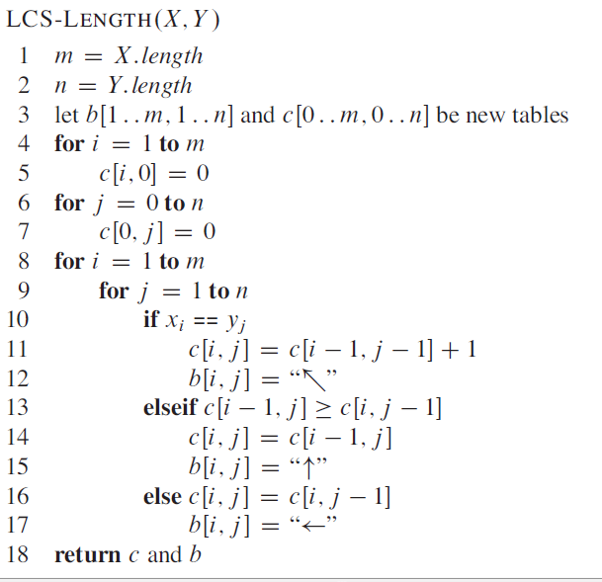

Slide 94
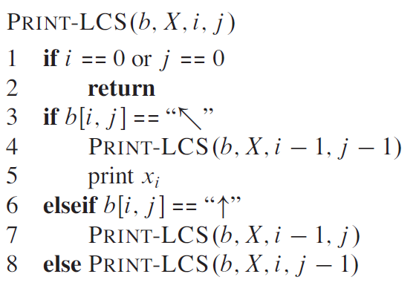
The procedure takes time O(m +n),
since it decrements at least one of i and j in each recursive call.

Slide 95
Dynamic-programming algorithm
IDEA:
Compute the table bottom-up.
Time = Θ(mn).
Reconstruct LCS by tracing backwards.
 |  | A | B | C | B | D | A | B
 | 0 | 0 | 0 | 0 | 0 | 0 | 0 | 0
B | 0 | 0 | 1 | 1 | 1 | 1 | 1 | 1
D | 0 | 0 | 1 | 1 | 1 | 2 | 2 | 2
C | 0 | 0 | 1 | 2 | 2 | 2 | 2 | 2
A | 0 | 1 | 1 | 2 | 2 | 2 | 3 | 3
B | 0 | 1 | 2 | 2 | 3 | 3 | 3 | 4
A | 0 | 1 | 2 | 2 | 3 | 3 | 4 | 4
0
0
1
1
2
2
3
3
4
4
November 7, 2005
L15.30

Slide 96
Dynamic-programming algorithm
IDEA:
Compute the table bottom-up.
Time = Θ(mn).
Reconstruct LCS by tracing backwards.
 |  | A | B | C | B | D | A | B
 | 0 | 0 | 0 | 0 | 0 | 0 | 0 | 0
B | 0 | 0 | 1 | 1 | 1 | 1 | 1 | 1
D | 0 | 0 | 1 | 1 | 1 | 2 | 2 | 2
C | 0 | 0 | 1 | 2 | 2 | 2 | 2 | 2
A | 0 | 1 | 1 | 2 | 2 | 2 | 3 | 3
B | 0 | 1 | 2 | 2 | 3 | 3 | 3 | 4
A | 0 | 1 | 2 | 2 | 3 | 3 | 4 | 4
0
0
1
1
2
2
3
3
4
4
November 7, 2005
L15.30

Slide 97
Dynamic-programming algorithm
IDEA:
Compute the table bottom-up.
Time = Θ(mn).
Reconstruct LCS by tracing backwards.
Space = Θ(mn). Exercise: O(min{m, n}).
 |  | A | B | C | B | D | A | B
 | 0 | 0 | 0 | 0 | 0 | 0 | 0 | 0
B | 0 | 0 | 1 | 1 | 1 | 1 | 1 | 1
D | 0 | 0 | 1 | 1 | 1 | 2 | 2 | 2
C | 0 | 0 | 1 | 2 | 2 | 2 | 2 | 2
A | 0 | 1 | 1 | 2 | 2 | 2 | 3 | 3
B | 0 | 1 | 2 | 2 | 3 | 3 | 3 | 4
A | 0 | 1 | 2 | 2 | 3 | 3 | 4 | 4
0
0
1
1
2
2
3
3
4
4
November 7, 2005
L15.31

Slide 98
Reference
Introduction to Algorithms
Thomas H. Cormen
Chapter # 15

Slide 99
http://lcs-demo.sourceforge.net/

